Slide 1
Law of Supply

Slide 2
Introduction
The law of supply describes the relationship between price and amount supplied when all other variables remain constant (ceteris paribus). As the price of a commodity increases, the supply of that commodity in the market also increases and vice-versa.

Slide 3
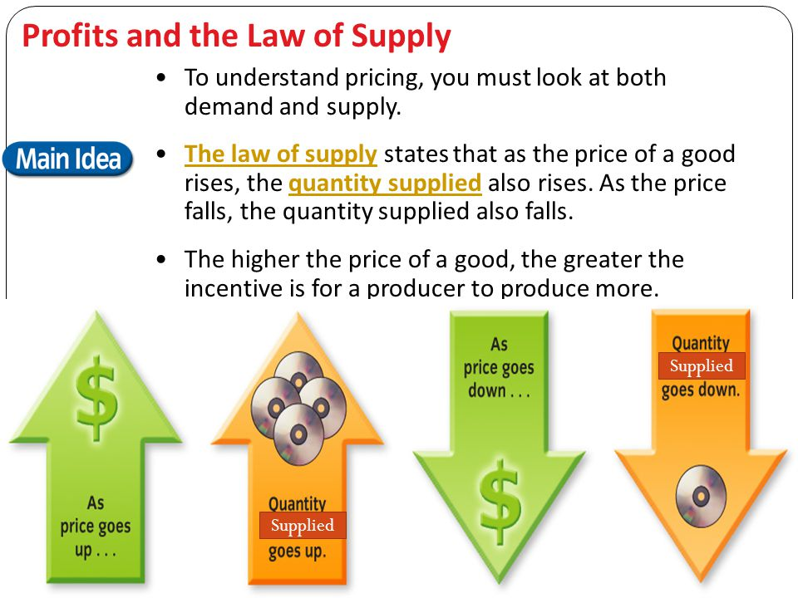
For Example

Slide 4
Assumptions
The price of other commodities is constant.
The state of technology has not changed.
The price of factors of production is constant.
The taxation laws remain the same.
The producer’s objectives are constant.

Slide 5
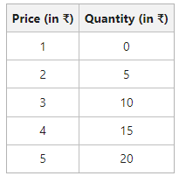
Schedule

Slide 6
